Slide 1
Legacy of Hatred
Revelation 12

Slide 2
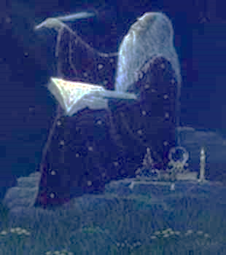
From the Creator’s Viewpoint
BC (“E”)
Something happened
AD (“CE”)
“Smartass Age”
“Great Trouble”
Revelation 12:1 (KJV) And there appeared a great wonder in heaven…
Because there Is
Direction
There is
Which gives our lives
Purpose
Significance
Notes:
Using KJV = BEST!? → “Great Wonder”
“In Heaven” = G’s V.P. = ** WOG/John “Apocalypse”
= **Course..Hist: **BC ** Cross ** AD **Smartass w/o G **Trouble
Import: **Direction **Purp. **Signif. → ~LOSE TRACK!!

Slide 3
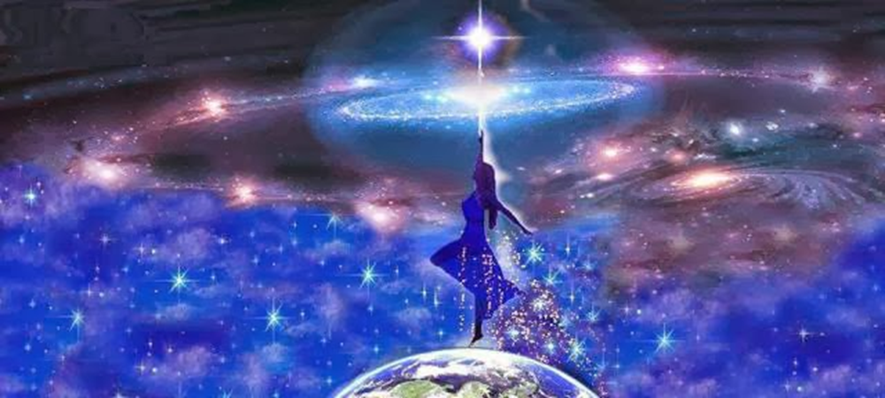
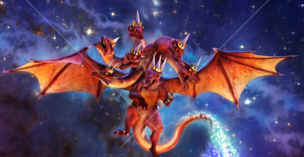
Three Central Figures
Revelation 12:1-2 (NASB) …appeared in heaven: a woman clothed with the sun, and the moon under her feet, and on her head a crown of twelve stars; and she was with child; and she cried out, being in labor and in pain to give birth.
Revelation 12:3 (NASB) Then another sign appeared in heaven: and behold, a great red dragon having seven heads and ten horns, and on his heads were seven diadems.
Notes:
3 Figures=FR

Slide 4
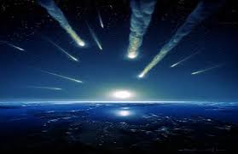
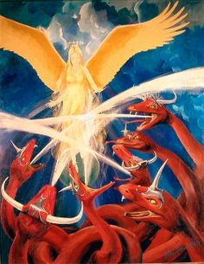
Three Central Figures
Revelation 12:4 And his tail swept away a third of the stars of heaven and threw them to the earth.
And the dragon stood before the woman who was about to give birth, so that when she gave birth he might devour her child.

Slide 5
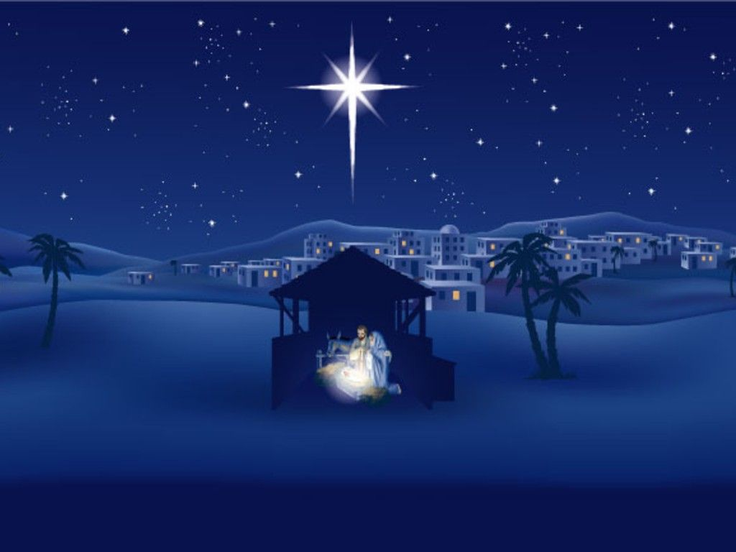
Three Central Figures
Revelation 12:5 And she gave birth to a son, a male child, who is to rule all the nations with a rod of iron; and her child was caught up to God and to His throne.
Child is JC
Psalm 2:2-3 (NLT) The kings of the earth prepare for battle; the rulers plot together against the LORD and against his Anointed One.
“Let us break their chains,” they cry, “and free ourselves from slavery to God.”
Psalm 2:8-9 “Only ask, and I [The Creator God] will give you the nations as your inheritance, the whole earth as your possession. You will break them with an iron rod and smash them like clay pots.’”
Notes:
?? Child ?? → **JC → BABY!!?? → **Ps.2 Fulfilled

Slide 6
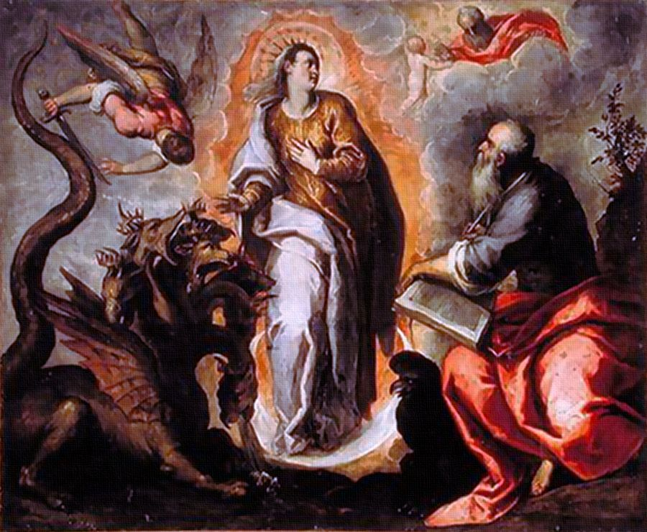
Three Central Figures
Revelation 12:6 Then the woman fled into the wilderness where she had a place prepared by God, so that there she would be nourished for one thousand two hundred and sixty days.
The Woman is Israel
Protected 3½ Years
Vital Role in the Great Tribulation
The Birth of the Messiah (“King”)
Romans 9:4-5 (NLT) God revealed his glory to the Israelites. He made covenants with them and gave them his Revelation. He gave them the privilege of serving him and receiving his wonderful promises…and the Messiah himself was an Israelite as far as his human nature is concerned. And he is God, the one who rules over everything and is worthy of eternal praise!
Notes:
** Protected = EAST → Petra → JC Mentions
** Vital Role = 144k Witnesses → JC=Messiah
** Messiah= **Rsn 2b Chosen →TODAY: ??Chosen??
Will Come 2 Senses→STOP WAITING

Slide 7
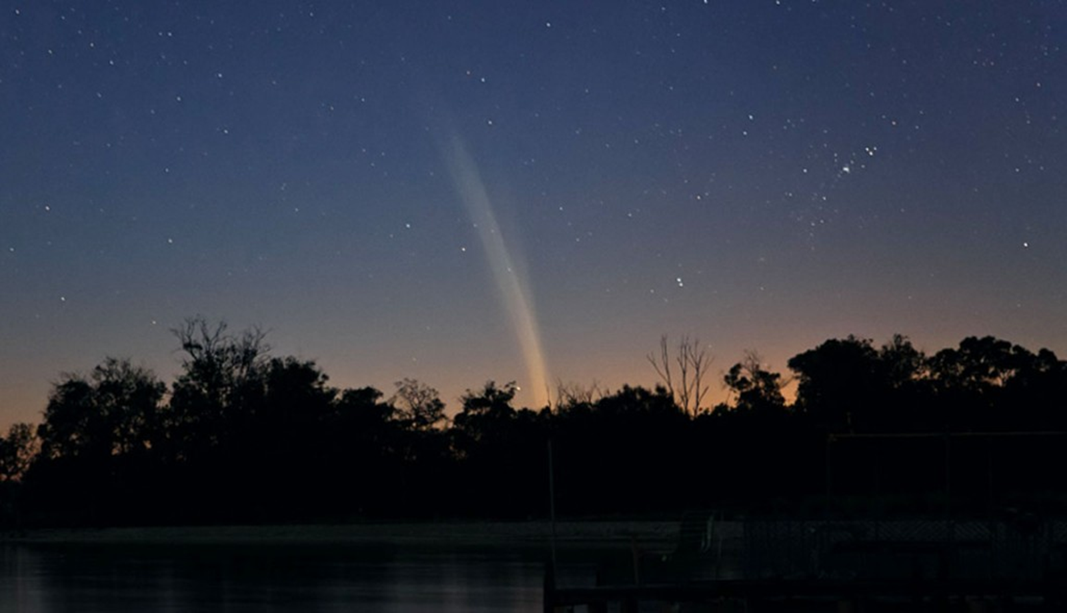
Legacy of Hatred
Rebelled Against God
Joined by “1/3 of the stars” (angels)
Exiled to Planet Earth
Revelation 12:7-9 (NLT) Then there was war in heaven. Michael and his angels fought against the dragon and his angels. And the dragon lost the battle, and he and his angels were forced out of heaven. This great dragon—the ancient serpent called the devil, or Satan, the one deceiving the whole world—was thrown down to the earth with all his angels.
Notes:
** Earth=GARBAGE DUMP =TEEMING with Violence
** Rebelled → Ezek.28 PWRFUL → “I Will…”
**Following → ** Exiled: by OTHER ANGELS

Slide 8
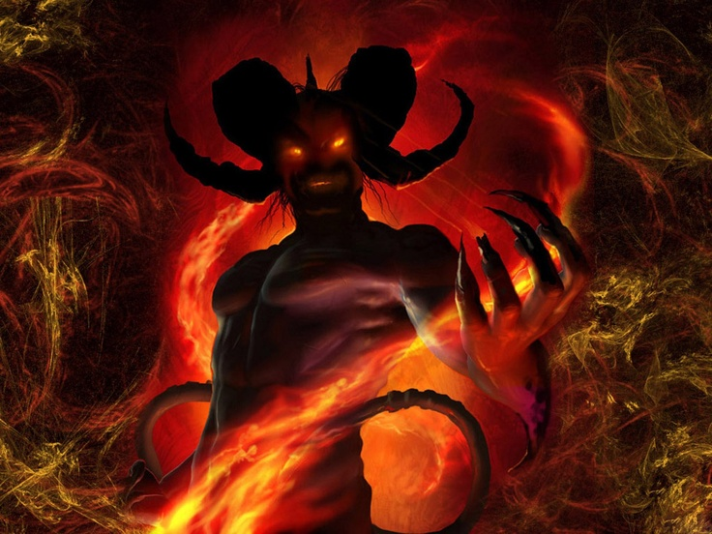
Legacy of Hatred
Weapons of Mass Destruction
Deceit
Accusation
Revelation 12:7-9 The ancient serpent called the devil, or Satan, the one deceiving the whole world—was thrown down to the earth with all his angels.
Jeremiah 14:14 Then the LORD said to me, "The prophets are prophesying falsehood in My name. I have neither sent them nor commanded them nor spoken to them; they are prophesying to you a false vision, divination, futility and the deception of their own minds.
Jeremiah 5:31 God says: “Prophets prophesy falsely, and the priests rule on their own authority; and My people love it so! But what will you do at the end of it?”
Notes:
Deceit=POISONOUS→Pervasive → ** WMD=Madison 5th Av
** via “Prophets” → ~PROOF!?!? → **Ppl LOVE Altern.
IL: Mormons→Indians=10 Tribes / Blacks ~Allowed, etc.
IL: HELIOS → SUN?? IL: Oscillating Universe → SAGAN

Slide 9
Legacy of Hatred
Weapons of Mass Destruction
Deceit
Accusation
“Let me at them!”
Revelation 12:10 Then I heard a loud voice shouting across the heavens, “It has come at last— salvation and power and the Kingdom of our God, and the authority of his Christ. For the accuser of our brothers and sisters has been thrown down to earth— the one who accuses them before our God day and night.
Job 1:10-11 "Have You not made a hedge about him and his house and all that he has, on every side? You have blessed the work of his hands, and his possessions have increased in the land. "But put forth Your hand now and touch all that he has; he will surely curse You to Your face."
Luke 22:31-32 "Simon, Simon, LOOK! Satan has demanded permission to sift you like wheat; but I have prayed for you, that your faith may not fail; and you, when once you have turned again, strengthen your brothers."
2 Corinthians 12:7-9 …to keep me from exalting myself, there was given me a thorn in the flesh, a messenger of Satan to torment me—to keep me from exalting myself! …And He has said to me, "My grace is sufficient for you, for power is perfected in weakness."
Notes:
#2=Accusation→Xians → **”LET ME!!” =We Protected
** Job→ “Remove HEDGE” ** Peter=PROUD: “~Go2 Jerus!”
S: “He’s ~Under Ur Authority” → “CONCEIT=Snare..Devil”
??Allow?? → ** “Strengthen…” =Broken=Anti-Pride

Slide 10
Legacy of Hatred
Defenses
The Love From the Messiah
Testify!
Loving God’s Way
Revelation 12:11 "And they overcame him because of the blood of the Lamb and because of the word of their testimony, and they did not love their life even when faced with death.
Notes:
“Overcame” = ** Defenses ** BLOOD=Anti-Accusat: LUTHER
??U Deal w/ Guilt/Mistakes/Weakness? → Self-Justif? ^ JC-Justif?
**Testify→We=Voice of Sanity/Exposing
→Nd.LOUD/CONFID. Voice! → ~Fight Flesh/Blood
**Loving G’s Way: ~Suicidal → Luv 4 JC
=Overcomes: Luv MISSING Frm W.S.=Arrangements
→S.Hates LUV → HATES U→ &R Fellowship
Luv 4 JC=Ultimate Loyalty → DIE! =OK!! = JOY!!

Slide 11
Legacy of Hatred
Revelation 12:12 (NLT) Therefore, rejoice, O heavens! And you who live in the heavens, rejoice! But terror will come on the earth and the sea, for the devil has come down to you in great anger, knowing that he has little time.”
Veneer
Reality
Notes:
~B Deceived → **Veneer → **Reality=Destruction
AP: U=Signif/Purp IF Know Creator’s Purpose

Slide 12
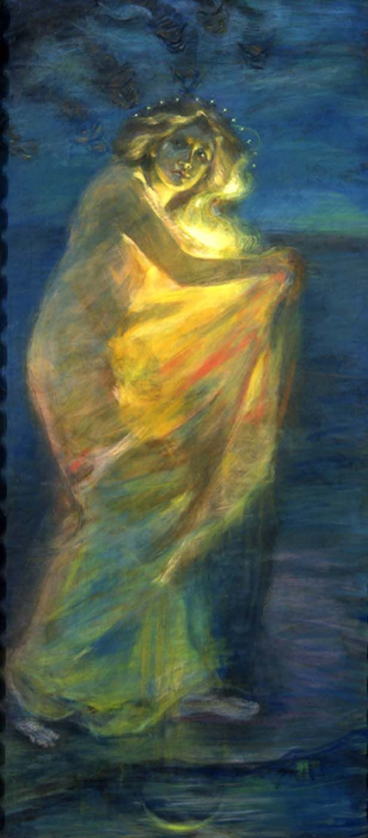
Legacy of Hatred
BC (“E”)
Something happened
AD (“CE”)
“Smartass Age”
“Great Trouble”
Revelation 12:15-16 Then the dragon tried to drown the woman with a flood of water that flowed from his mouth. But the earth helped her by opening its mouth and swallowing the river that gushed out from the mouth of the dragon.
Lethal Anti-Semitism
God saves His people
Zech. 14 Nations at Israel’s Doors
“Second Advent”
Notes:
2Day: ISRAEL= **Central the COURSE of HISTORY
Wrld=Shld Ask: “?? Israel So Central…”

Slide 14
Three Careers
1) The Career of Satan

Slide 15
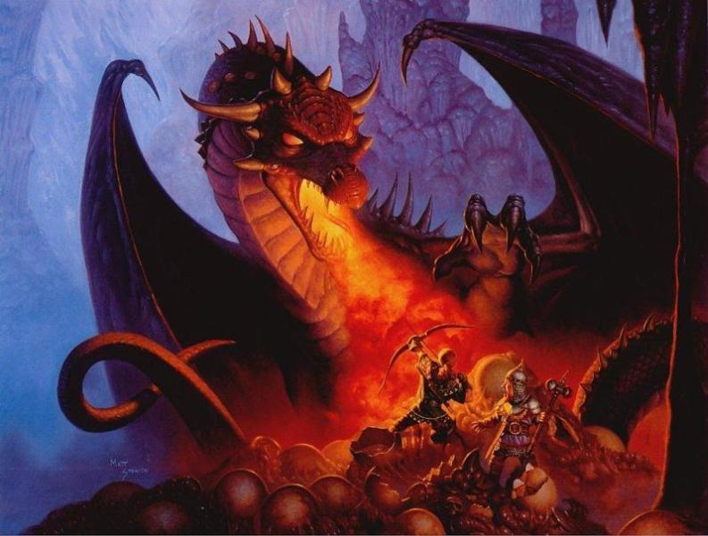

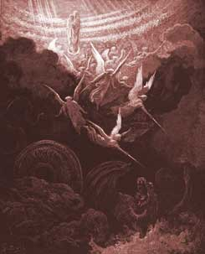


Slide 16
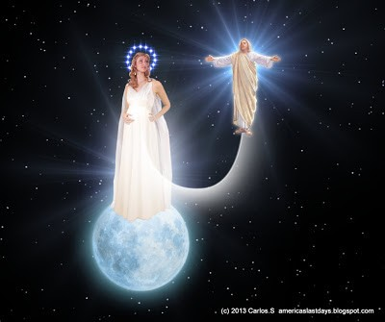
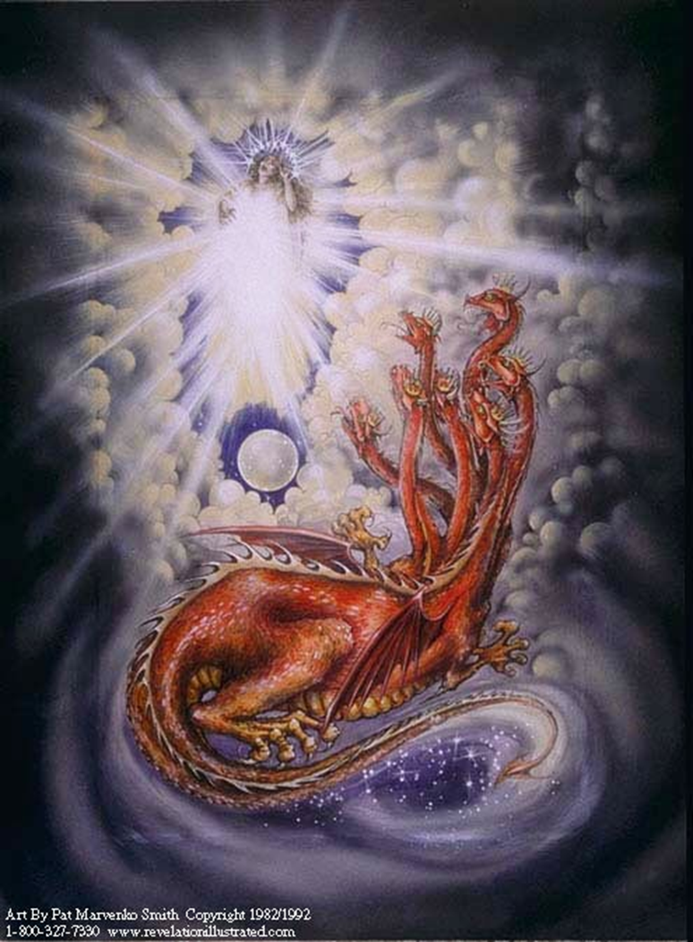


Slide 17

